Slide 1
Training of Facilitators

Slide 2
Learning Objectives
Participants of this training will be able to:
List the core elements and theoretical framework of the Healthy Divas intervention
Facilitate Healthy Divas sessions

Slide 3
Introductions & Icebreaker

Slide 4
If you could live inside of any movie, book, or TV show, which one would it be and why?
In 30 seconds (or less) please.

Slide 5
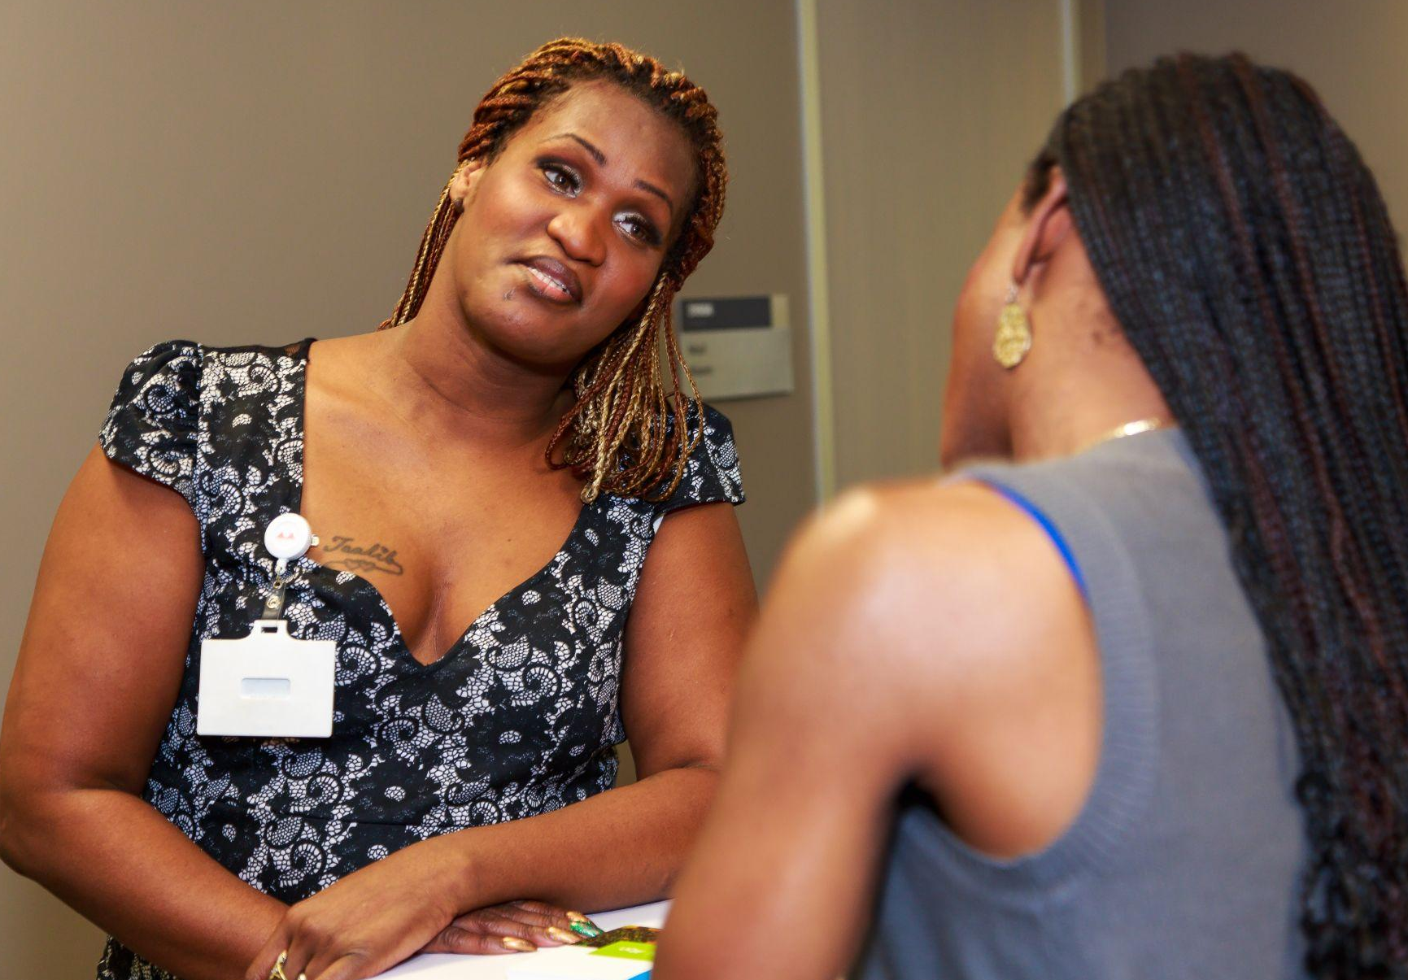
Healthy Divas:
6 sessions with peer counselor
1 group workshop with provider
Funded by NIH/NIMH R01MH106373 (PI: Sevelius), California HIV/AIDS Research Program IDEA award, UCSF Academic Senate Individual Investigator Grant 555242-34935, CAPS Innovative Award

Slide 6
Healthy Divas Logic Model
NEED
Improving HIV, PrEP, and overall health outcomes for transgender women
CARE CONTINUUM OUTCOMES
Increase HIV & STI testing
Increase linkage to care
Improve engagement and/or retention in care
Improve uptake and adherence to ART or PrEP
SERVICE IMPACT
Number of transgender women served
Number of HD sessions per client
Number engaged & retained in care, adherent to meds
Client satisfaction
IMPLEMENTATION ACTIVITIES
Engage local trans communities
Hire and train peer facilitators
Train staff on HIV and PrEP treatment and assessment of adherence, engagement behaviors and satisfaction
Develop a local trans resource guide
Train staff to provide supportive services and referrals
Provide supervision
Adaptation (as needed)
Access ongoing TA on intervention and trans community
Collect process and outcome measures
ELIGIBILITY CRITERIA
Transgender women (assigned male at birth but does not identify as male) over the age of 18.
CORE ELEMENTS
Trans-identified peer counselor
Six one-on-one sessions
Group workshop with gender affirming medical provider
Provide supportive services and referrals
INTERVENTION ACTIVITIES
Outreach, recruitment, retention
6 individual sessions with peer counselor to discuss personal and health history and goals
1 group workshop with participants and medical provider on Gender Affirming Care, PrEP & HIV prevention & care
Discuss impact of substance use and other barriers and facilitators
Provide supportive services and referrals
MEASURES
Longitudinal follow-up of aggregate and patient-level client outcomes at sub-awardee level
CONCEPTUAL FRAMEWORK
Gender Affirmation
Health Care Empowerment
Trauma-Informed Care
Motivational Interviewing
GRANT TYPES AND SUPPORT
Organizational Sub-Award
CCTA Technical Assistance
EC Technical Assistance
EVALUATION TOOLS
Fidelity monitoring
Client satisfaction questionnaire

Slide 7
Core Elements of the Healthy Divas Intervention
Trans-identified peer counselor
Six one-on-one sessions
Group workshop with gender affirming, PrEP knowledge and HIV prevention and/or care provider or providers
Provide supportive services and referrals

Slide 8
Intervention Activities
Outreach, recruitment, retention
6 individual sessions with peer counselor to discuss personal and health history and goals
1 group workshop with participants and medical provider on Gender Affirming, PrEP & HIV prevention and/or care
Discuss impact of substance use and other barriers and facilitators
Provide supportive services and referrals

Slide 9
Pre-implementation Activities
Hire and train peer facilitators
Train providers on trans-competent care (if needed)
Train staff to assess adherence, engagement behaviors and satisfaction
Train staff to provide supportive services and referrals
Collect process and outcome measures
Provide supervision
Adaptation (as needed)
Technical Assistance

Slide 10
Theoretical Framework of

Slide 11
Conceptual Model: Model of Gender Affirmation and Model of Health Care Empowerment
Gender Affirmation Model
Model of Health Care Empowerment
Psychosocial factors
• Transphobia (experienced/internalized)
• Trauma History
• Social support
• Life stability (SES, housing, sex work)
• Substance use
Access to Gender Affirmation
Gender affirmation needs met
Engaged
Informed
Collaborative
Committed
Tolerant of Uncertainty
Engagement and retention in HIV care
Need for Gender Affirmation
Adapted from Sevelius Sex Roles 2012
Adapted from Johnson AJPH 2012

Slide 12
Need for Gender Affirmation
Access to Gender Affirmation
Desire for transition-related procedures
Gender affirming health care
Desire to be affirmed as female
Affirming relationships: Family, peers, and/or lovers and sex partners
Desire to live authentically
Ability to “pass” / live in the correct gender
(Sevelius, J 2012, Sex Roles)

Slide 13
Need for Gender Affirmation
Access to Gender Affirmation
Desire for transition-related procedures
Gender affirming health care
Desire to be affirmed as female
Affirming relationships: Family, peers, and/or lovers and sex partners
Desire to live authentically
Ability to “pass” / live in the correct gender
(Sevelius, J 2012, Sex Roles)

Slide 14
Effects of Gender Affirmation
Decreased depression, anxiety
Improved health, quality of life
Decreased sexual risk
Need for Gender Affirmation
hormones surgery social affirmation
leads to
(Budge et al. 2013; White-Hughto & Reisner, 2016; Sevelius, in press)

Slide 15
Session One: Let’s Be
Real!
Introduction, Knowledge and Resource Overview

Slide 16
Session Objectives
SESSION ONE
Clients will:
Understand the structure and goals of the program
Identify beliefs related to health, HIV prevention or treatment, and gender goals
Learn about setting attainable goals
Identify a short-term health related goal
Receive workshop preview
Complete gender affirming exercise

Slide 17
SESSION ONE
Worksheet 1A: Health History Care and Life Context
Overview
Health Care History
HIV prevention and/or care history
Medication History
Substance Use
Beliefs and Support

Slide 18
SESSION ONE
Demonstration: Health History Care and Life Context
[Open Intervention Manual to Worksheet 1A]
We know that trans women are having a hard time adhering to HIV and PrEP medications. We are really interested in understanding what some of the unique challenges they face and finding ways of support them in achieving better health outcomes.”
“

Slide 19
SESSION ONE
Health History Care and Life Context
Discuss worksheet 1A
How do we ask sensitive questions?
Brief demonstration

Slide 20
SESSION ONE
Activity Worksheet 1B: My Personal Health Vision
Participant identifies vision of healthy future self
Participant identifies steps to reaching vision
Make sure to include PrEP and HIV care Adherence

Slide 21
SESSION ONE
Worksheet 1C: Measuring and Tracking Health Care Goals
It’s important when setting “attainable goals” to be sure they are things over which they have control. Something the client can complete before their next session.

Slide 22
Gender Affirmation Exercise

Slide 23
SESSION ONE
Gender Affirmation Exercise
[Open Intervention Manual to Activity 6]
overview
practice

Slide 24
SESSION ONE
Gender Affirmation Exercise
Decreased depression, anxiety
Improved health, quality of life
Decreased Sexual risk
Link back to theories
Why is this important and related to everything you’ve learned today?

Slide 25
[break]

Slide 26
Session Two: Be
Fierce!
Personal Strengths and Resiliency

Slide 27
Session Objectives
SESSION TWO
Clients will:
Discuss progress towards goals
Identify personal strengths
Understand what role personal strengths can play in achieving health and HIV prevention or treatment goals
Identify a short -term health related goal
Complete gender affirmation exercise

Slide 28
Check In
SESSION TWO
Discuss significant events since last session:
• What has happened in participant’s life?
• Keep in mind that issues may come up.
• Those issues may be important to problem solve around.
• How has the participant been feeling?
• Any thoughts about last session?

Slide 29
SESSION TWO
Measuring and Tracking Goals
Discuss progress towards goal…
• How does participant feel about meeting goal?
• What helped participant follow through with goal?
• Was goal partially met?
• Did participant make some progress towards goal or related to goal? (This is worth fully exploring because often participant has taken step towards goal without even realizing it)
If so:

Slide 30
Demonstration: Health History Care and Life Context
SESSION TWO
Overview: Activity 2 Strengths Identification
[sample script]
Today we are going to be talking about personal strengths. Being a trans woman and making your way through all the challenges of the world requires a unique set of strengths, talents, skills, and positive qualities. Recognizing these strengths and instances in which you have used or exercised these strengths can be helpful.”
“

Slide 31
SESSION TWO
Practice Activity 2 / Worksheet 2A: Personal Strengths and Motivators
It takes lot of strength and conviction to be a trans woman. What are some of the skills and qualities you have that have helped you along the way?
What are things about you or things you do that you are proud of, as well as people or things that bring meaning to your life or give you reason to want to be the best you can be?”
“

Slide 32
SESSION TWO
Worksheet 1C: Measuring and Tracking Health Care Goals
It’s important when setting ‘attainable goals’ to be sure they are things over which you have control.”
“

Slide 33
[lunch break]

Slide 34
Group Workshop: It’s all about
Us!
Group Workshop Preparation and Expectations

Slide 35
Workshop Objectives
GROUP WORKSHOP
Clients will:
Increase knowledge of HIV and PrEP medication and HIV prevention strategies
Increase knowledge of Gender Affirming Care
Learn and practice strategies for communicating effectively with health care providers
Practice Gender Affirmation Exercise

Slide 36
Preparation
GROUP WORKSHOP
Now you generate some preparation questions together!
Who will facilitate your workshop?
Where will the workshop be?
Do you have a gender affirming HIV care provider that is also knowledgeable about PrEp treatment that will co-facilitate?

Slide 37
GROUP WORKSHOP
Expectations: Activity 1 Welcome & Introductions
Explain participant workshop packet
Review agenda/timeline, including breaks
Discuss logistics (e.g., turn off cell phones, bathrooms, use, getting in and out of building, review weapons and drug and alcohol policy, etc.)
Ground rules for discussion:
Need for safety and respecting difference
Confidentiality and limits to confidentiality
Right to Pass
What to do if feeling overwhelmed /triggered
Payment procedures if participation in Healthy Divas is incentivized
Explain reference materials
Answer participant questions about anything covered thus far

Slide 38
GROUP WORKSHOP
Expectations: Engage and Support Participants
Engage participants in problem solving around any potential barriers to successfully attending and participating in the workshop with their peers.
Engage participants in discussion around specific barriers (who, what, where why).
Engage participants in discussion of possible solution to barrier.
Help participants identify what she considers the best solution.
Explore why participants feels this is the best solution.
Develop a plan that promotes future conversations of empowering sisterhood.

Slide 39
GROUP WORKSHOP
Workshop Content
Activity 1: Welcome and Introduction
Activity 2: Creating client concerns and questions list
Activity 3: Gender treatment overview
BREAK
Activity 4: HIV Treatment and HIV prevention strategies overview (including PrEP)
Activity 5: Maximizing a successful collaboration with providers
Activity 6: Gender Affirmation Exercise

Slide 40
R E L A X A T I O N E X E R C I S E

Slide 41
Session Three:
Get it ?
Assertive Communication

Slide 42
Session Objectives
SESSION THREE
Clients will:
Discuss experience of workshop, if attended, process information presented, and identify remaining concerns
Discuss progress towards goals
Revise Personal Health Vision*
Learn and practice communication skills
Apply communication skills to increase health care engagement
Identify a short -term health related goal
Complete gender affirmation exercise

Slide 43
SESSION THREE
Activity 3: Demonstration Communication Practice
[Using worksheet 3A: Assertive Communication Handout and Worksheet 3B Active Listening Handout]
Discuss strategies for staying calm and present during provider visits. Refer to breathing exercises, gender affirmation exercise.
Practice/role-play a situation of participant asking her provider or doctor for a service or something she wants.

Slide 44
Session Four: Keep it
Together!
Utilizing Support

Slide 45
Session Objectives
SESSION FOUR
Clients will:
Discuss progress towards weekly goal and Personal Health Vision*
Learn about types of social support, and consider Impact of stigma, transphobia, trauma, and substance use on social support asked for and received
Identify sources for social support in client’s own network**
Match types and sources of available social support to goals in client’s Personal Health Vision
Set a new health-related goal
Complete gender affirmation exercise

Slide 46
SESSION THREE
SESSION FOUR
Activity 3: Review and Practice Support
Using Worksheet 4A: Social Support, help participant identify current support networks in her life. It's important to recognize that relationships can be a source of many stressors in our lives.
The facilitator might want to begin the exercise by asking the participant what does social support look like in their life. Which relationships are barriers that block her ability in reaching her goals?
Explore how experiences with stigma, transphobia, and past trauma has influenced her self-esteem and beliefs around self- reliance, affect allowing others to support her.
If there is current or past substance use, explore the relationship dynamic or impact it has had on people in her life.

Slide 47
SESSION THREE
SESSION FOUR
Activity 4: Who’s in your Circle?
Getting the Support You Need
Draw from this session’s review of the client’s Personal Health Vision to identify challenges that can be transferred to the first column on Worksheet 4B.
Have client identify people and resources that could be helpful around each challenge listed.
Ask client to think about whether there are new sources of support the client could utilize around some components of the plan.
Are there organizations on the resource list that might be helpful?

Slide 48
Gender Affirmation Exercise:
Practice

Slide 49
[break]

Slide 50
Session Five: Work it
Out!
Celebrating Successes and Working Through Challenges

Slide 51
Session Objectives
SESSION FIVE
Clients will:
Discuss and reinforce progress towards goals*
Identify recent successes and amplify them
Identify challenges to reaching health and HIV treatment- or prevention-related goals
Set a new health-related goal
Complete gender affirmation exercise

Slide 52
Session Six: Healthy
Diva!
Future Health

Slide 53
Session Objectives
SESSION SIX
Clients will:
Discuss progress towards goals
Identify continued healthcare challenges/barriers to care*
Problem-solve one challenge related to healthcare engagement
List future goals, visualize future success

Slide 54
SESSION SIX
Activity 3: Review
Review skills learned and topics covered in program. Help client identify how she has utilized skills.
Setting attainable goals
Strength and Resiliency
Workshop Health information, working with others to create a supportive bond
Communication with providers
Support circle
Celebrating successes
Working through challenges
Envisioning the future

Slide 55
Questions and Next Steps

